Slide 1

Tracking vehicle using GPS and update location on IoT dashboard
Anuranan Das(22535006)
Divyanshu Shukla(22535010)

Slide 2

Introduction
In this project we are building a IOT based vehicle tracking system to get the live location of a vehicle.
Using the vehicle tracking system we are getting the current the location of vehicle as longitude and latitude in the form of google links on our mobile phone.
We have also added the calling feature to device in case of emergency.
We are also updating the values of longitude and latitude on the AI thinks iot dashboard.

Slide 3

Devices Used
SIM808 GSM/GPRS/GPS MODULE
ARDUINO UNO
12V Adapter
Jumper Wires

Slide 4
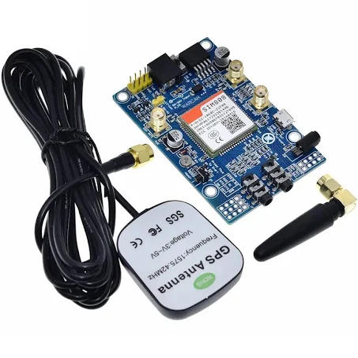



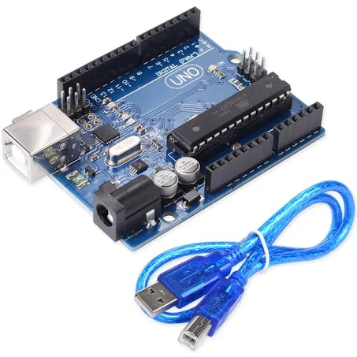
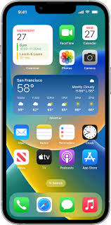
Project Architecture
SIM 808 GPS/GSM/GPRS Module
Thingspeaks Dashboard
2G Network
Internet
SMS of location
Arduino Uno
Mobile phone

Slide 5

Working of the project:
Connect the SIM808 module to microcontroller using jumper wires and connect power supply to GPRS module using 12V adapter.
Create an account on ThingSpeaks IOT dashboard.
Write the sketch to receive the data from module and send location to mobile and IOT dashboard.
Receives the GPS data on mobile through sms and inget a call on mobile phone.
Look for updated location on ThingSpeaks dashboard.
Keep the power supply on to continuously get the location.

Slide 6
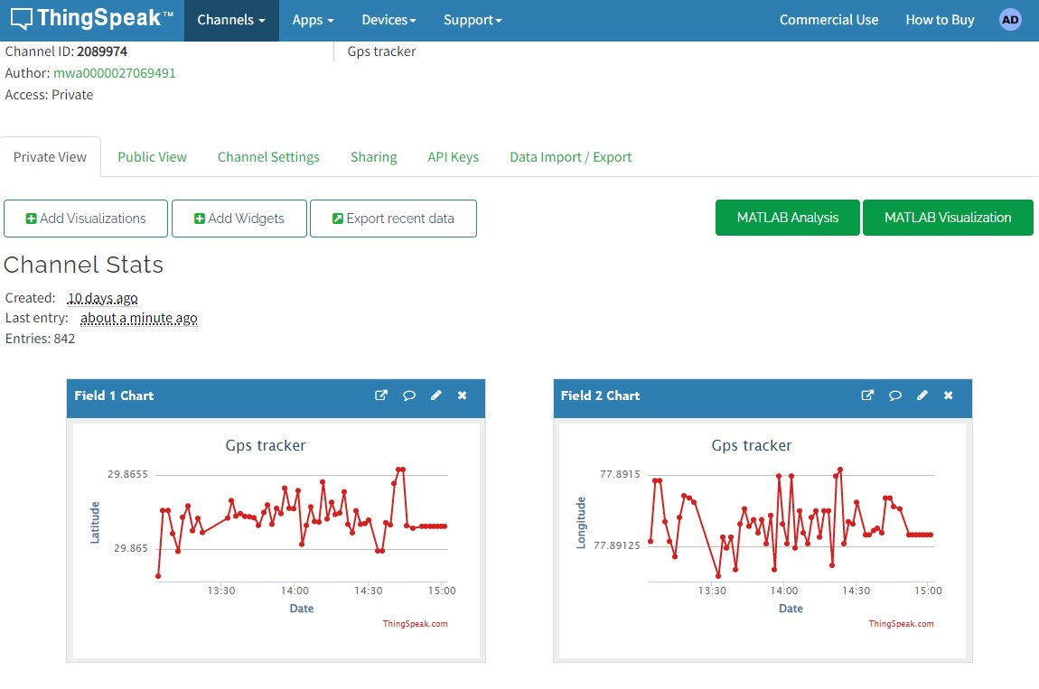
Live location on dashboard

Slide 7
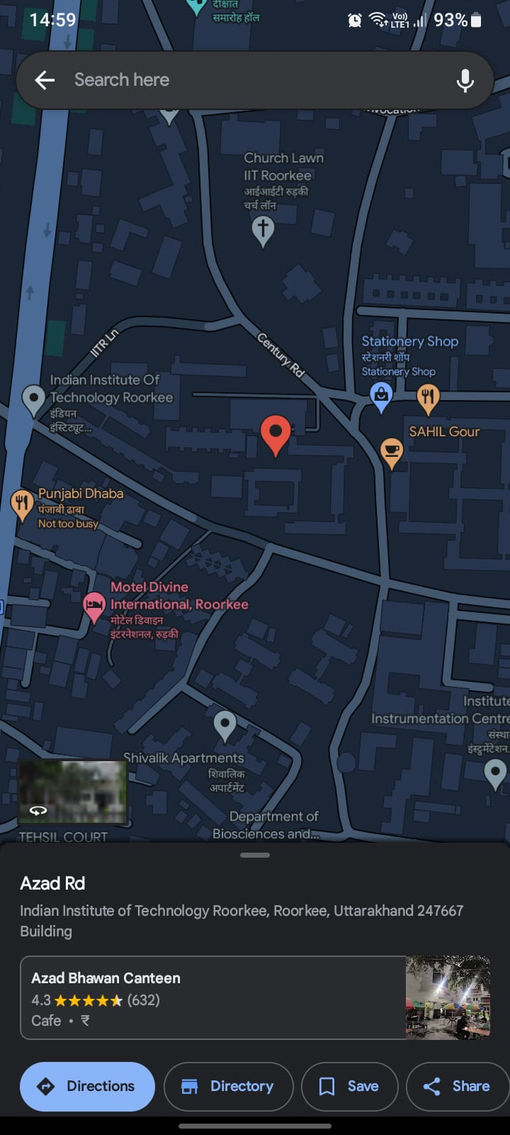
Location on Google Maps

Slide 8
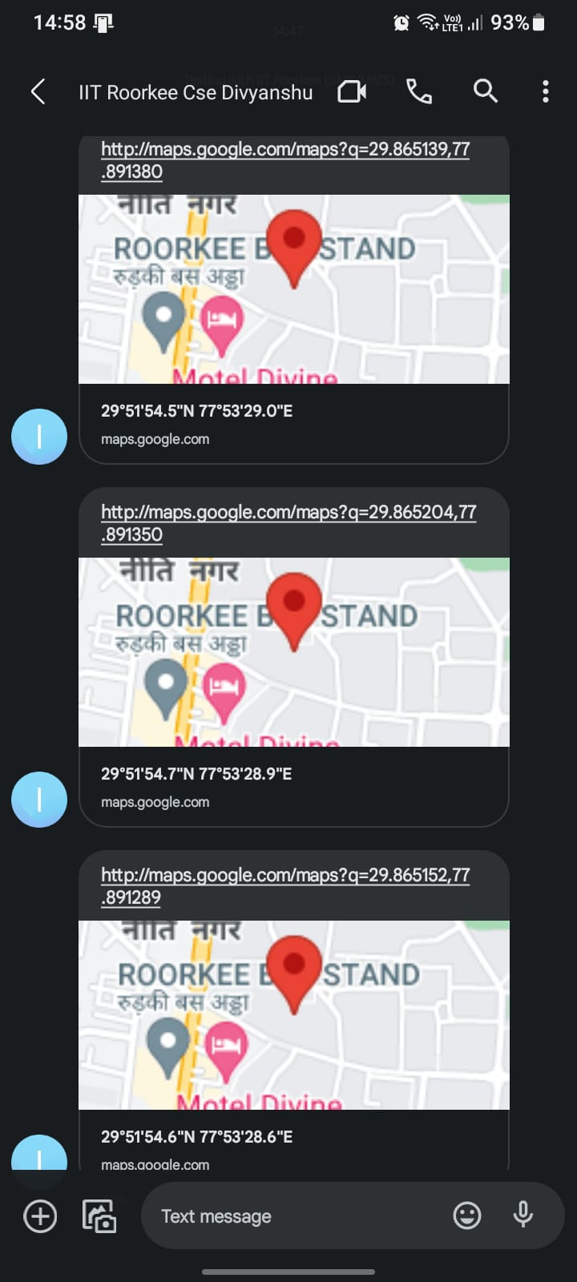
SMS on Phone

Slide 9
APPLICATIONS
We can use vehicle tracking system in fleet management.
We can use this in asset tracking system.
We can use this in safety purposes like woman and child.
Can be used to avoid accidents of vehicle.

